Slide 1
Distinguish disaster information among tweets
(Kaggle)

Slide 2
Outline
Objective and Significance
Question definition
Background
Model design
Data description
Schematic
Word embedding model
Milestone and timeline

Slide 3
Objectives and Significance
Objective:
build a classifier that can predict whether a piece of tweet is reporting a real disaster.
Significance:
Get familiar with basic concepts in natural language processing.
Hands-on experience with NLP and deep learning libraries: NLTK and tensorflow.
Implement and train the state of art NLP algorithm: transformer.
Lay down a foundation for more advanced NLP applications.

Slide 4
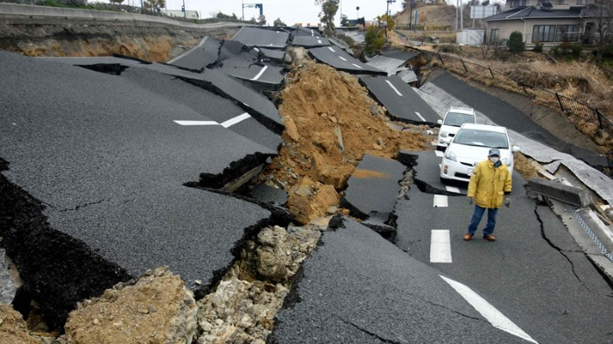

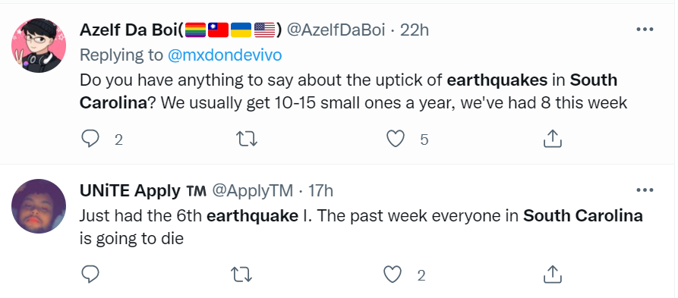
Background (1)
Twitter has become an important communication channel in times of emergency (earthquake, wildfire, tornado…)
Sometimes disaster information can be found on twitter hours before official announcements, which can lead to faster response and save hundreds of lives.

Slide 5
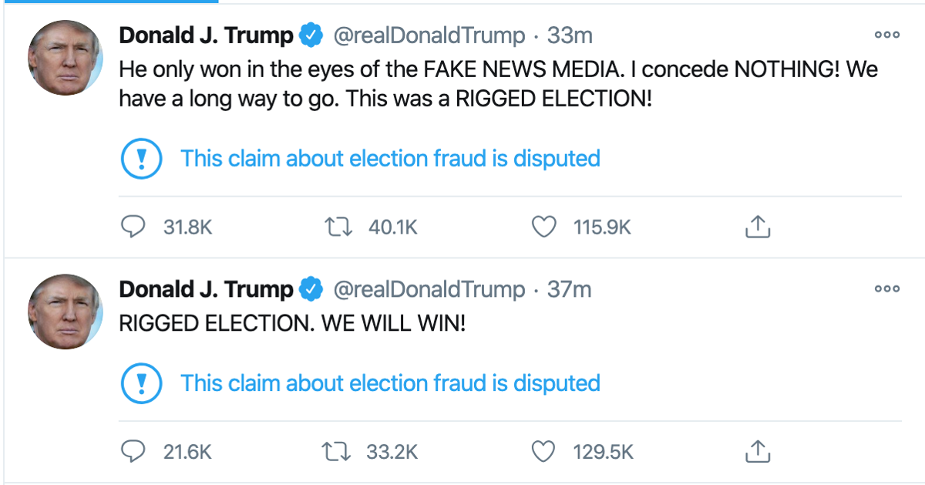
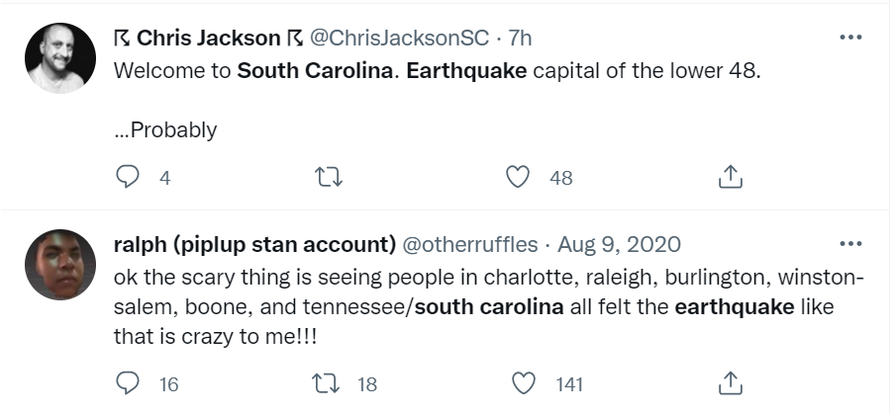
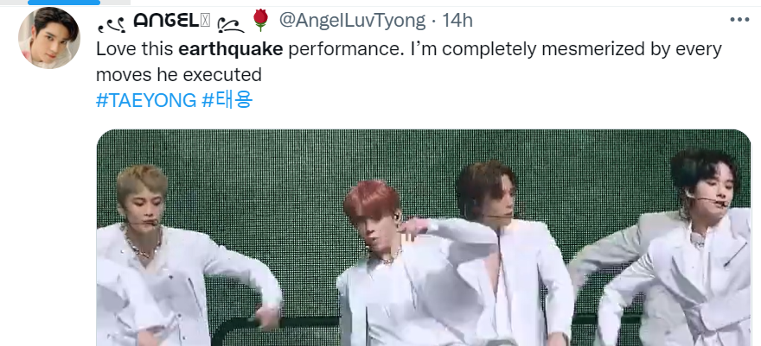
Background (2)
The word “earthquake” can be used metaphorically .
True
False

Slide 6
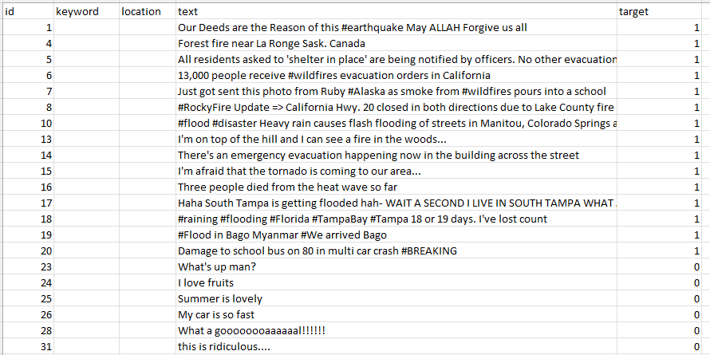
Data description
Statistical characteristics:
Total number: 7614
Positive: 3271
Negative: 4343
P/N ratio: 0.7532
With keyword:
With location:
Positive with keyword:
Positive with location:
Negative with keyword:
Negative with location:
Min. length of context:
Max. length of context:
……
One training example:
Index Keyword (optional) Location (optional) Context Label
Data loading and preprocessing
(https://towardsdatascience.com/a-gentle-introduction-to-natural-language-processing-e716ed3c0863)

Slide 7
Schematic
Positive samples
Positive vectors
@bbcmtd Wholesale Markets ablaze http://t.co/lHYXEOHY6C
Forest fire near La Ronge Sask. Canada
Word embedding
Classifier
Prediction
Negative samples
Negative vectors
Do you like pasta?
Rene Ablaze &amp; Jacinta - Secret 2k13 (Fallen Skies Edit)

Slide 8
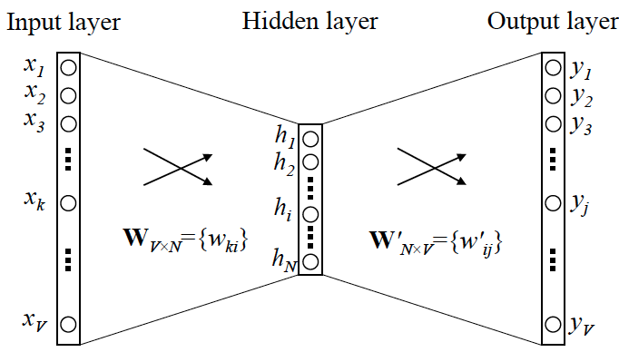
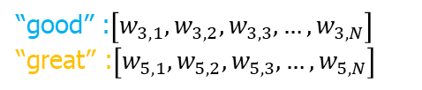
Word embedding
One-hot encoding
Common bag of words
E.g.:
Assume “good” → [0,0,1,0,0]
Want “great” → [0,0,1.2,0,0]
Words with similar meaning should be similar in the vector space.
Original dataset
Have a good day.
Have a great day.
Similar words appear in similar contexts.
E.g.:
Have a good day.
Have a great day.
Vocabulary
Train the following encoder-decoder:
“have”
“a”
“good”
“day”
“great”
[1,0,0,0,0]
[0,1,0,0,0]
[0,0,1,0,0]
[0,0,0,1,0]
[0,0,0,0,1]
“good”
“day”
0
0
1
0
0
0
0
0
1
0
“great”
Sentence vector
0
0
0
0
1
[1,1,1,1,0]
[1,1,0,1,1]
Skip-gram
BERT ()
Word2vec function
“good” :$\left[w_{3,1},w_{3,2},w_{3,3}, …,w_{3,N}\right]$
“great” :$\left[w_{5,1},w_{5,2},w_{5,3}, …,w_{5,N}\right]$
Should be very similar.

Slide 9
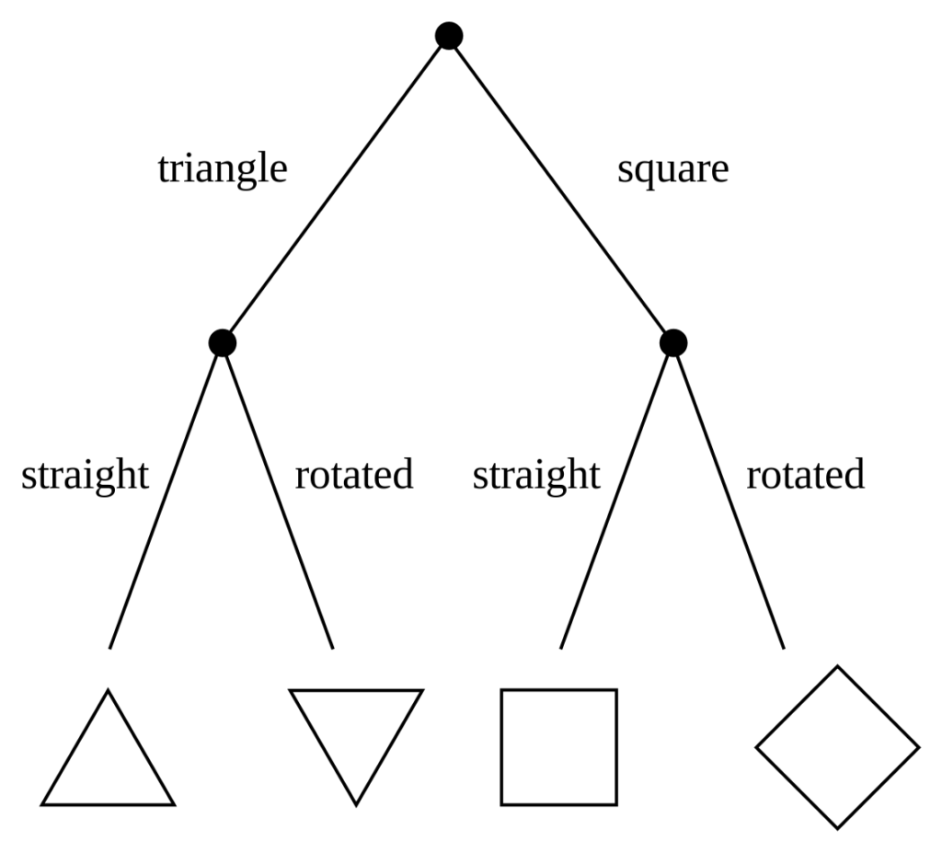
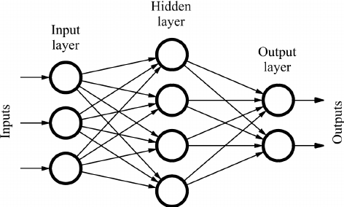
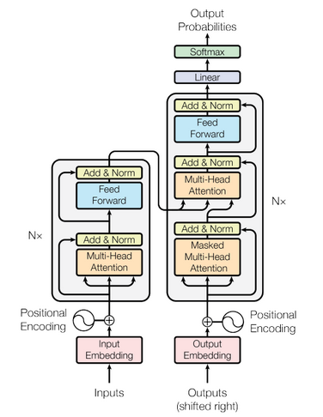
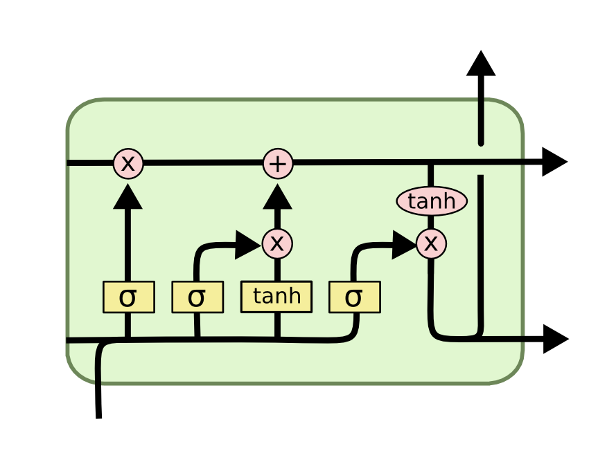
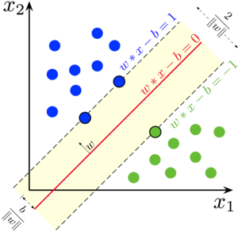
Classifier
Decision Tree
Feedforward neural network
Transformer (SOA)
Support vector machine
LSTM

Slide 10
Milestone and timeline
Get familiar with the techniques
Design the model
Assign responsibilities and tasks
Implement prototypes
Finalize the model design
Test model performance
Finetune the parameters
Submit the results
01/07/2022
Start the project
04/07/2022
End the project

